Slide 1
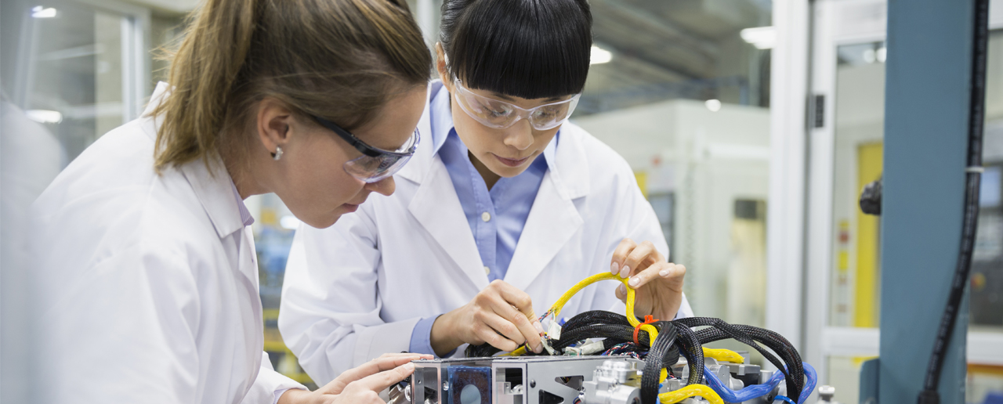
RUDRA
Team: ai for life
Harshal Raikwar(leader)
Shyam Mehta

Slide 2


Problem Statement
In this modern era crime and theft are increasing day by day, and to fight with them and protect us our Police take every essential step. The aim of this project to make an Web Application to assist the Police staff and Public, and making their work easier. In todays time it is not as easy task to handle report for Police as well as Public, to identify thief, or they don’t have time to write report/complain, or some privacy issues.

Slide 3


Solution Overview
Assisting Police and Public
Identifying thief with accuracy
Easy communication
Easy crime reporting
Easily accessible

Slide 4

Methodology
For Image Recognition we are using AI ML through TensorFlow for identifying suspect and illegal products.
For frontend we have used React Js (only for firearm Detection) and jQuery.
For developing backend we have used JavaScript.
For styling we have used CSS and Bootstrap.

Slide 5

Features
POLICE SECTION
Easy and accurate identification of suspect with use of AI ML.
Easy and accurate identification of illegal products.
Available in Multiple Languages.
User can add notes.
Chatbot assistance.
PUBLIC SECTION
Easy reporting of theft.
Chatbot assistance.
Available in Multiple Languages.
Easy to use.

Slide 6

Impact
Accessible
Easy to use, with various functions.
Accurate
As we are using AI the accuracy rate is very high.
Compatible
As a Web Application it is compatible with series of devices.

Slide 7

Future Scope
Analysis of Legal Documents The Al software can detect important patterns and can help in figuring out the correlations it can help legal practitioners in their case by furnishing judgements and also precedent law which can be used by them.
Electronic Billing Legal software used in Al technology is used for the preparation of invoices for the lawyers according to the work carried out by them. This helps the firm and the lawyer to decipher the accurate billing of the work done by the legal practitioner.
Let put our minds together and see what life we can make..

Slide 8
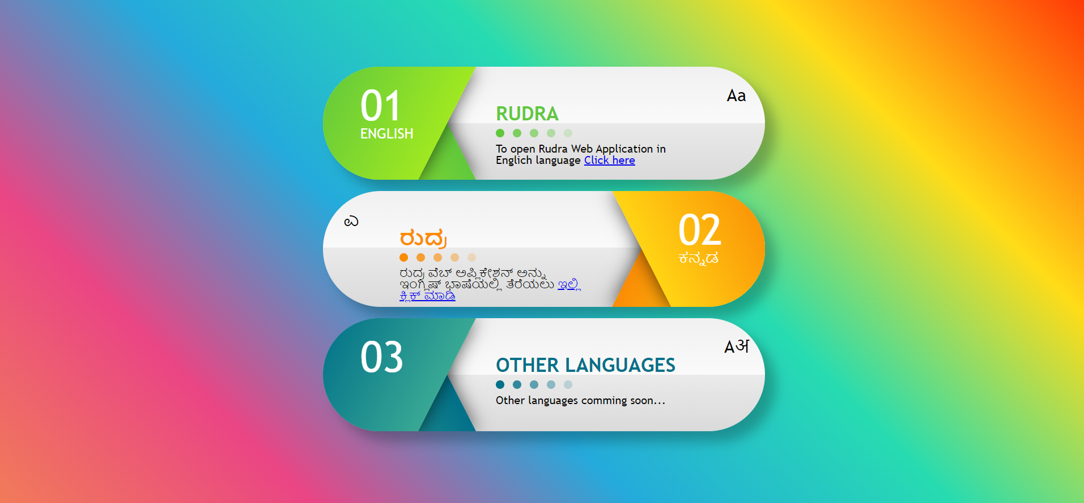
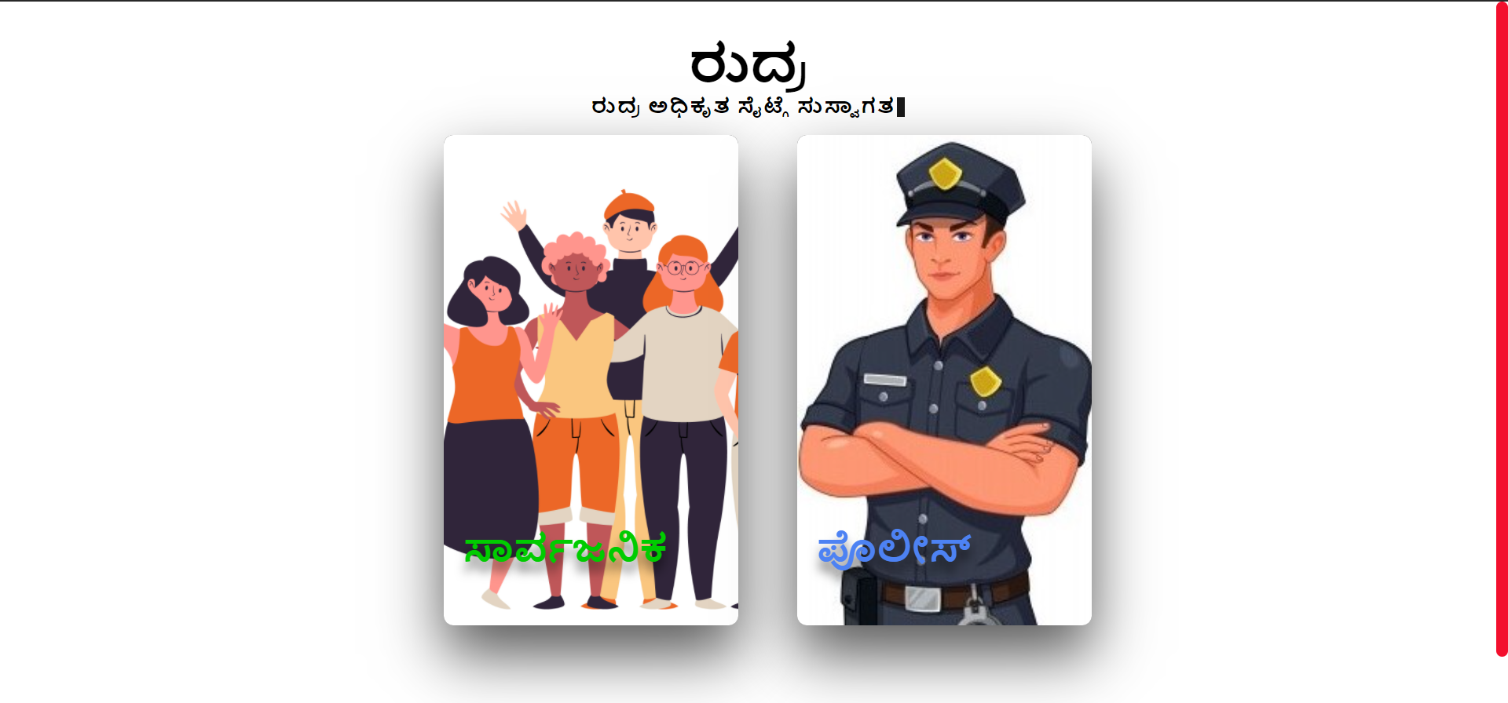
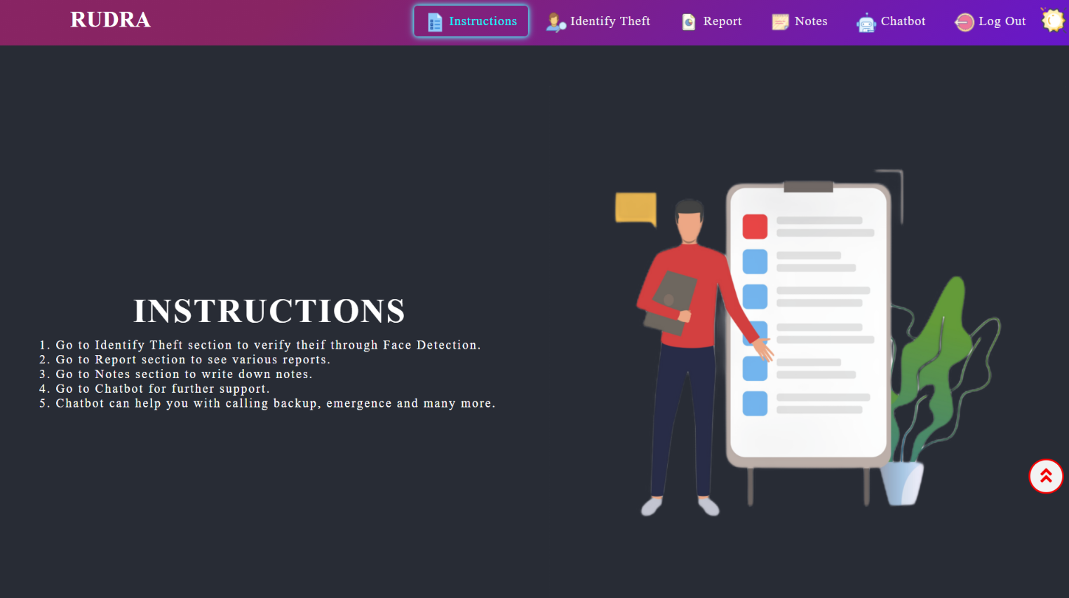
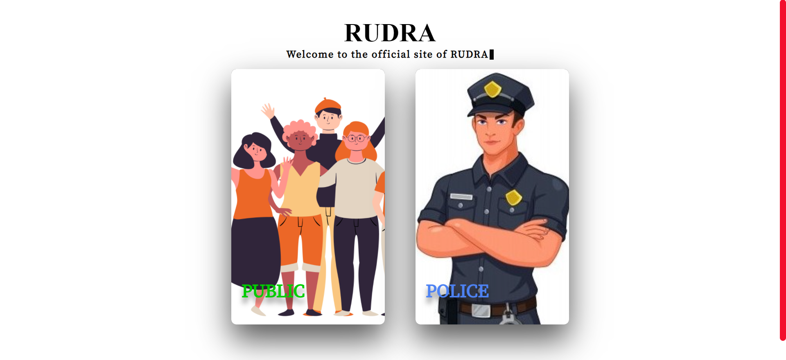

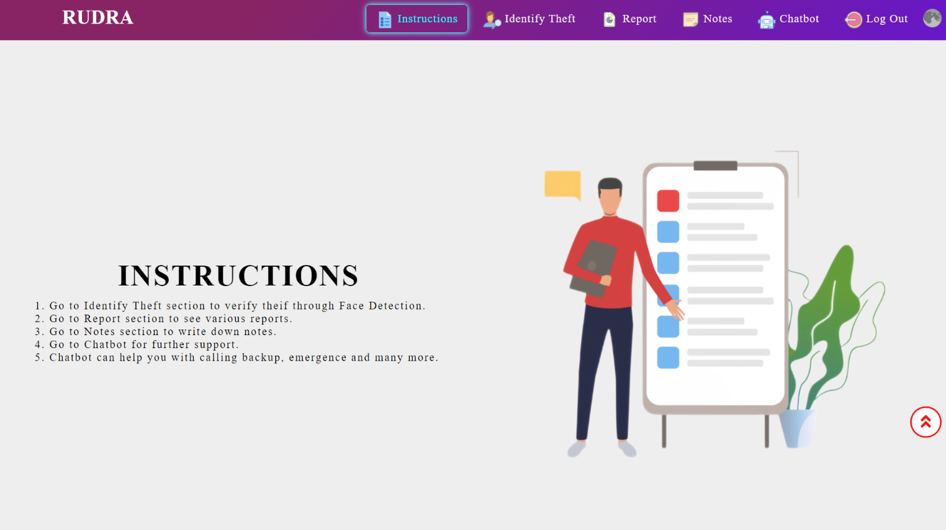
Gallery

Slide 9

Thank You!
GitHub Repository Link: https://github.com/Harshal0902/DSCWOW_Rudra
Demo Link: https://rudraweb.netlify.app/

